Slide 1
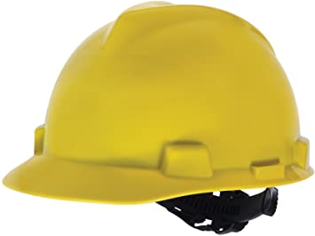
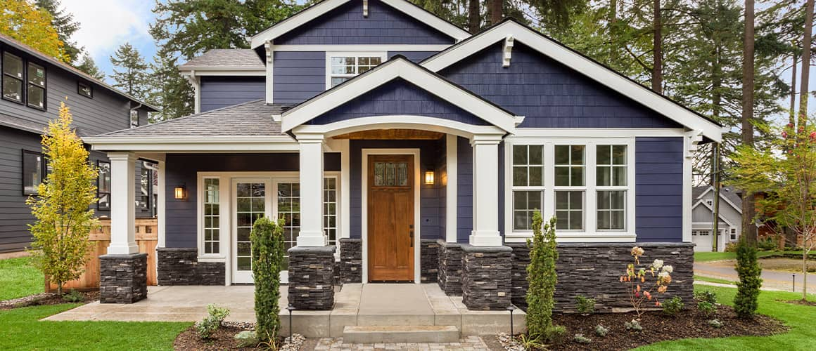
Dream House Construction Cost Estimator
Arisa Nguyen
W200 Project 1: 10/26/2021

Slide 2
Description
This program estimates the construction costs of a house with attributes set by the user
Also allows user to set budget and make changes to their house attributes
Construction costs only (not design, land, permitting, etc.)
Attributes are as general as sqft to as specific as kitchen appliances
Found average rates and location multiplier online (eg. Phoenix = 1.031, San Francisco = 1.039)

Slide 3
Modules / Classes
Room
Feature
Kitchen
Bathroom
House (module)
Dreamhouse (class)
Room (class)
Bathroom (subclass)
Kitchen (subclass)
Feature (class)
Compare (class)
Budget (class)
Compare
Dreamhouse
Budget
Main.py

